Slide 1
Chapter 1
Welcome Abroad

Slide 2

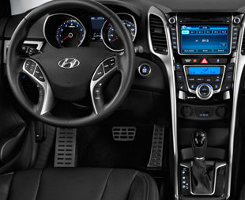
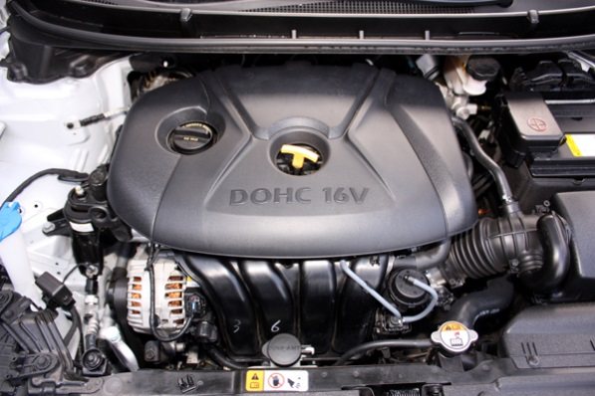
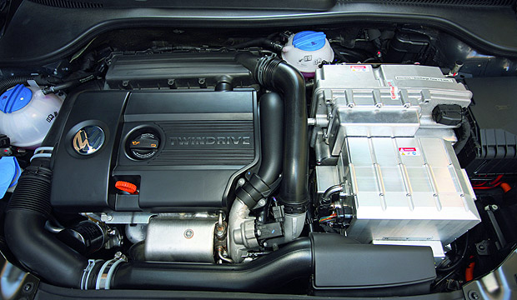
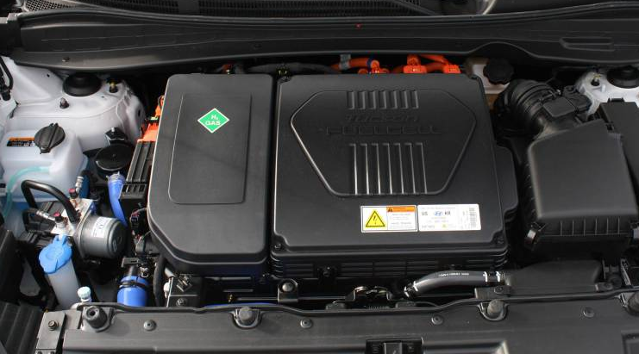
Abstraction
Interface
Source: http://static.usnews.rankingsandreviews.com/images/Auto/izmo/365609/2014_hyundai_elantra_gt_dashboard.jpg
http://www.ridelust.com/wp-content/uploads/2012/12/Engine2.jpg
http://www.plugincars.com/sites/default/files/Volkswagen-Golf-Variant-twinDRIVE-under-the-hood.jpg
http://wpmedia.driving.ca/2015/02/img_4777.jpg?quality=70&strip=all&w=960&h=480&crop=1
1-<number>

Slide 3
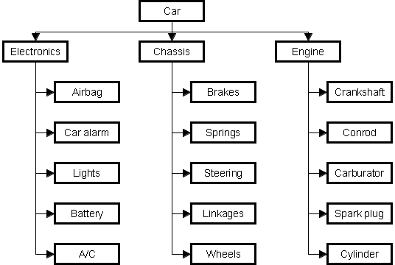
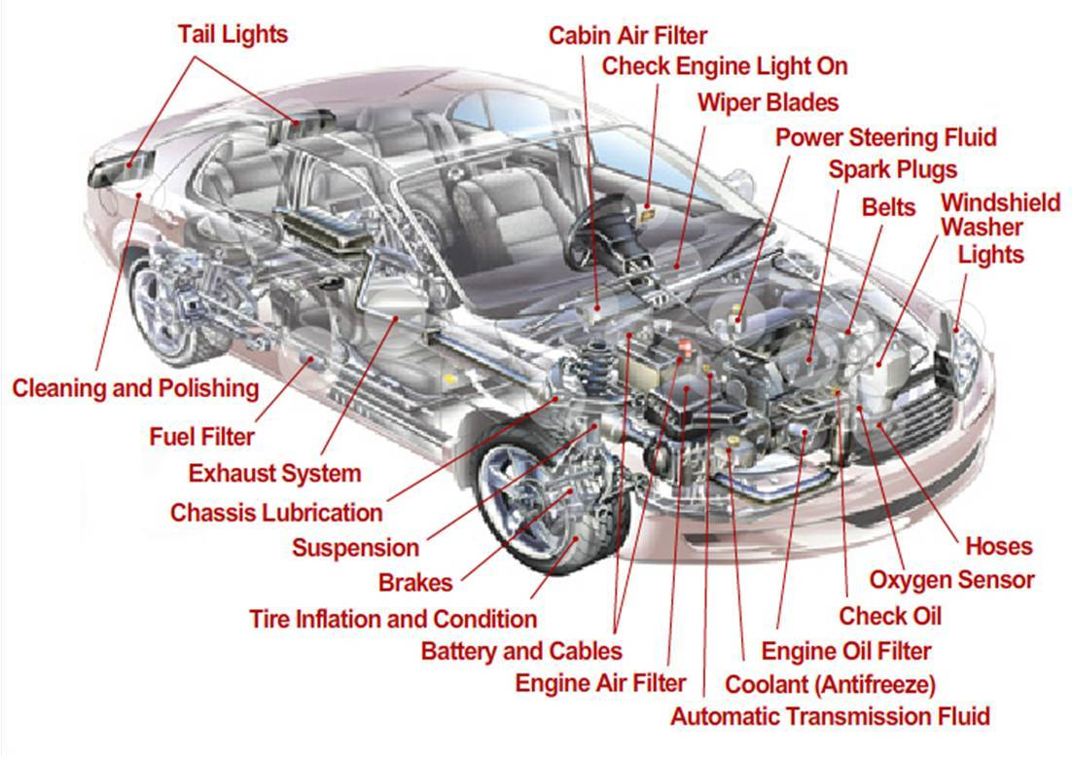
Levels of Abstraction (Man-made)
1-<number>
Source: https://whatsoftwarecando.org/wp-content/uploads/2015/05/auto-en.png
https://i1.wp.com/onstedcarshow.com/wp-content/uploads/2016/11/Elegant-Car-Components-Diagram-Car-Diagram-92-For-Car-Design-Ideas-with-Car-Components-Diagram-Car-Diagram.jpg?fit=1102%2C778

Slide 4
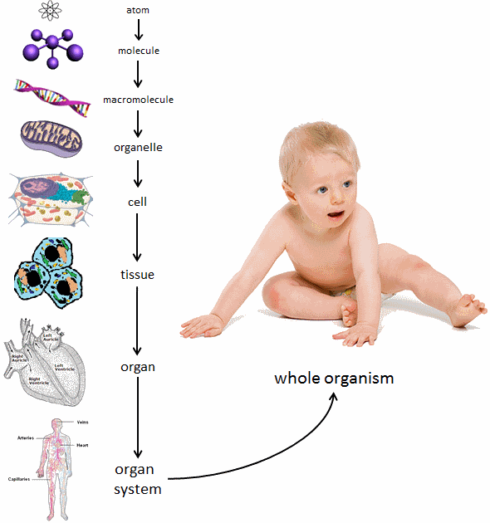
Levels of Abstraction (Biological System)
Source: https://media.studyisland.com/pics/40040_bio_organization.gif
1-<number>

Slide 5
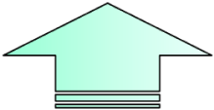
Levels of Abstraction (Computer)
Problems
Algorithms
Language
Instruction Set Architecture
Hardware/Software Interface
Microarchitecture
Circuits
Devices
1-<number>

Slide 6
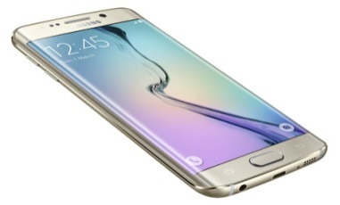
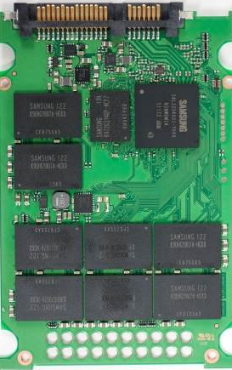
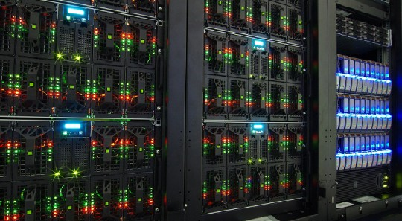

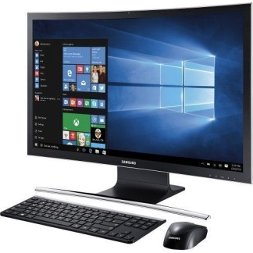
Universal Computing Device
All computers, given enough time and memory,
are capable of computing exactly the same things.
=
=
Embedded
Processor
Supercomputer
Then what is the simplest possible computing device?
Source: http://images.anandtech.com/reviews/storage/Samsung/SSD830/_DSC2164.jpg
http://www.miscw.com/wp-content/uploads/2016/09/Samsung-Smartphone.jpg
http://koreatechblog.com/wp-content/uploads/2015/02/lg-ultrapc-gram-14zd950-gx58k-1157540_2.jpg
https://4.imimg.com/data4/CO/YS/MY-29352968/samsung-desktop-computer-500x500.jpg
http://oiger.de/wp-content/uploads/Bull-Supercomputer.jpg
1-<number>

Slide 7
Turing Machine
Mathematical model of a device that can perform
any computation – Alan Turing (1937)
Every computation can be performed by some
Turing machine. (Turing’s thesis)
(그럼 이 세상에 계산하지 못하는 것도 있나? Yes…Halting Problem…We’ll discuss it later)
For more info about Turing machines, see
http://www.wikipedia.org/wiki/Turing_machine/
For more about Alan Turing, see
http://www.turing.org.uk/turing/
1-<number>

Slide 8
A Turing Machine
Tape
......
......
Read-Write head
Control Unit
Source: Prof. Costas Busch’s Lecture Slides http://www.cs.rpi.edu/~moorthy/Courses/modcomp/
1-<number>

Slide 9
The Tape
No boundaries -- infinite length
......
......
Read-Write head
The head moves Left or Right
Source: Prof. Costas Busch’s Lecture Slides http://www.cs.rpi.edu/~moorthy/Courses/modcomp/

Slide 10
......
......
Read-Write head
The head at each transition (time step):
1. Reads a symbol
2. Writes a symbol
3. Moves Left or Right
Source: Prof. Costas Busch’s Lecture Slides http://www.cs.rpi.edu/~moorthy/Courses/modcomp/

Slide 11






Example:
Time 0
......
......
Time 1
......
......
1. Reads
2. Writes
3. Moves Left
Source: Prof. Costas Busch’s Lecture Slides http://www.cs.rpi.edu/~moorthy/Courses/modcomp/

Slide 12
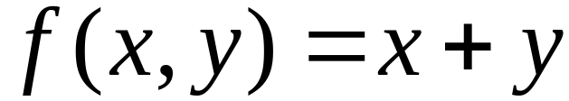

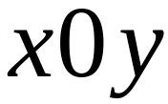
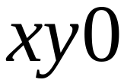
Computation Example
The function
is computable
are integers
Turing Machine:
Input string:
unary
Output string:
unary
Source: Prof. Costas Busch’s Lecture Slides http://www.cs.rpi.edu/~moorthy/Courses/modcomp/

Slide 13






Start
initial state
The 0 is the delimiter that
separates the two numbers
Source: Prof. Costas Busch’s Lecture Slides http://www.cs.rpi.edu/~moorthy/Courses/modcomp/

Slide 14

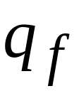
Start
initial state
Finish
final state
Source: Prof. Costas Busch’s Lecture Slides http://www.cs.rpi.edu/~moorthy/Courses/modcomp/

Slide 15

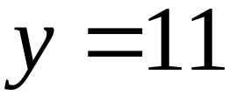

Execution Example:
Time 0
(=2)
(=2)
Final Result
Source: Prof. Costas Busch’s Lecture Slides http://www.cs.rpi.edu/~moorthy/Courses/modcomp/

Slide 16









Turing machine for function
Control Unit
Source: Prof. Costas Busch’s Lecture Slides http://www.cs.rpi.edu/~moorthy/Courses/modcomp/

Slide 17
Time 0
Source: Prof. Costas Busch’s Lecture Slides http://www.cs.rpi.edu/~moorthy/Courses/modcomp/

Slide 18
Time 1
Source: Prof. Costas Busch’s Lecture Slides http://www.cs.rpi.edu/~moorthy/Courses/modcomp/

Slide 19
Time 2
Source: Prof. Costas Busch’s Lecture Slides http://www.cs.rpi.edu/~moorthy/Courses/modcomp/

Slide 20
Time 3
Source: Prof. Costas Busch’s Lecture Slides http://www.cs.rpi.edu/~moorthy/Courses/modcomp/

Slide 21
Time 4
Source: Prof. Costas Busch’s Lecture Slides http://www.cs.rpi.edu/~moorthy/Courses/modcomp/

Slide 22
Time 4
Source: Prof. Costas Busch’s Lecture Slides http://www.cs.rpi.edu/~moorthy/Courses/modcomp/

Slide 23
Time 5
Source: Prof. Costas Busch’s Lecture Slides http://www.cs.rpi.edu/~moorthy/Courses/modcomp/

Slide 24
Time 6
Source: Prof. Costas Busch’s Lecture Slides http://www.cs.rpi.edu/~moorthy/Courses/modcomp/

Slide 25
Time 7
Source: Prof. Costas Busch’s Lecture Slides http://www.cs.rpi.edu/~moorthy/Courses/modcomp/

Slide 26
Time 8
Source: Prof. Costas Busch’s Lecture Slides http://www.cs.rpi.edu/~moorthy/Courses/modcomp/

Slide 27
Time 8
Source: Prof. Costas Busch’s Lecture Slides http://www.cs.rpi.edu/~moorthy/Courses/modcomp/

Slide 28
Time 9
Source: Prof. Costas Busch’s Lecture Slides http://www.cs.rpi.edu/~moorthy/Courses/modcomp/

Slide 29
Time 10
Source: Prof. Costas Busch’s Lecture Slides http://www.cs.rpi.edu/~moorthy/Courses/modcomp/

Slide 30
Time 11
Source: Prof. Costas Busch’s Lecture Slides http://www.cs.rpi.edu/~moorthy/Courses/modcomp/

Slide 31
Time 12
HALT & accept
Source: Prof. Costas Busch’s Lecture Slides http://www.cs.rpi.edu/~moorthy/Courses/modcomp/

Slide 32
Universal Turing Machine
A machine that can implement all Turing machines
-- this is also a Turing machine!
  inputs: data, plus a description of computation (other TMs)
T_{add}, T_{mul}
U
a,b,c
c(a+b)
Universal Turing Machine
U is programmable – so is a computer!
  instructions are part of the input data
  a computer can emulate a Universal Turing Machine and vice versa
A computer is a universal computing device.
1-<number>

Slide 33
Halting Problem
  Halting Problem
    The problem of determining, from a description of an arbitrary computer program (i.e., Turing machine) and an input, whether he program will finish running (i.e., halts) or continue to run forever
  Halting problem is undecidable (not Turing machine solvable)
    (Proof by an application of Cantor’s diagonal argument)
    오토마타 교과목에서 더 깊게 다루어짐.
1-<number>

Slide 34
꼭 기억해야 할 것
(Levels of) Abstraction
Turing Equivalence
Undecidable Problem (not Turing machine computable)
1-<number>

